Slide 1
Filter Filter #Filter #Controller #JavaEE
Kiều Trọng Khánh

Slide 2
Review
How to remove all java code in JSP (View)? Complete the MVC 2 Design Pattern with View
JSTL
How to build the data grid tag library using in JSP?
Tag Libraries
Model
Classical, Simple, and Handles
How to implement the custom Tag Lib and use it in JSP

Slide 3
Objectives
How to build application using MVC2 Pattern using Filter as Controller?
Filter
Filter Chain
Using Filter as Controller in MVC2 Design Pattern

Slide 4
Objectives
Web based App - PBL
Web
Day 1, 2, 3, 4, 5, 6 – Login
Servlet, JDBC
Day 7, 8, 9 – Search
Break Down
Day 10, 11 – MVC2
JSP
Day 12, 13, 14, 15 – CUD, Shopping Carts
Sessions
Day 16, 17 – Login
JavaBeans
Day 18, 19, 20 – CRUD
MVC 2 Complete - JSTL - Taglib
Day 21, 22, 23 – Filter
MVC2 Using Filter as Controller

Slide 5
Filter Requirements
Preprocess request and Postprocess response in web application
Build the Project CRUD, Online Shopping applying MVC2 pattern with Filter as Controller

Slide 6
Filter Overview
Are components that add functionality to the request and response processing of a Web Application
Intercept the requests and response that flow between a client and a Servlet/JSP.
Supports dynamic modification of requests and responses between client and web applications.
Dynamically access incoming requests from the user before the servlet processes the request
Access the outgoing response from the web resources before it reaches the user
Categorized according to the services they provide to the web applications
Resides in the web container along with the web applications
Was introduced as a Web component in Java servlet specification version 2.3

Slide 7
Filter Overview
Are components that add functionality to the request and response processing of a Web Application
Intercept the requests and response that flow between a client and a Servlet/JSP.
Supports dynamic modification of requests and responses between client and web applications.
Dynamically access incoming requests from the user before the servlet processes the request
Access the outgoing response from the web resources before it reaches the user
Categorized according to the services they provide to the web applications
Resides in the web container along with the web applications
Was introduced as a Web component in Java servlet specification version 2.3

Slide 8
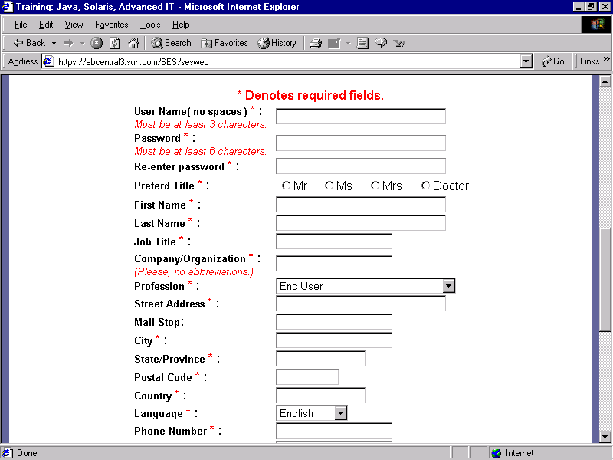
Filter Interactive Filter Model
1. Input and click button/link
3. Send request
4. Dispatch to Servlet/Web Container
Web/App Server
Containter
Filter 1 ..n
6. Process Request
2. Generate the Request msg
5. Generate Req Obj
7. chain.doFilter to n
→ pass request
12. Send response
8. Forward Request
10. Process Response (from n to 1) & Response
Resource
11. Container generate Res Msg
Client
9. Execute & Response
Server
Notes:
Revive: hồi sinh

Slide 9
Filter Usage
Authorize request
Altering request headers and modify data
Modify response headers and data
Authenticating the user
Comprising files
Encrypting data
Converting images
Logging and auditing filters
Filters that trigger resource access events

Slide 10
Filter Benefits - Advantages
Optimization of the time taken to send a response
Compression of the content size before sending
Optimization of the bandwidth
Security
Identify the type of request coming from the Web client, such as HTTP and FTP, and invoke the Servlet that needs to process the request.
Retrieve the user information from the request parameters to authenticate the user.
Validate a client using Servlet filters before the client accesses the Servlet.
Identify the information about the MIME types and other header contents of the request.
Facilitate a Servlet to communicate with the external resources.
Intercept responses and compress it before sending the response to the client

Slide 11
Filter Life Cycle
Working of Filter
The filter intercepts the request from a user to the servlet
The filter then provides customized services
The filter sends the serviced response or request to the appropriate destination
Instantiation and Loading
Initialization init()
doFilter()
destroy()
Unavailable

Slide 12
Filter API
Creates and handles the functionalities of a filter
Contains three interfaces
Filter Interface, FilterConfig Interface, FilterChain Interface
Filter Interface
Must be implemented to create a filter class extends javax.servlet.Filter
An object performs filtering tasks on the request and the response
Methods | Descriptions
init | - public void init(FilterConfig fg); - Called by the servlet container to initialize the filter - Called only once - Must complete successfully before the filter is asked to do any filtering work
doFilter | - public void doFilter(ServletRequest req, ServletResponse res, FilterChain chain) throws IOException, ServletException - Called by the container each time a request or response is processed - Then examines the request/response headers & customizes them as per the requirements - Passed the request/response through the FilterChain object to the next entity in the chain
destroy | - public void destroy(); - Called by the servlet container to inform the filter that its service is no more required - Called only once.
Notes:
ServletResponse hay Servlet Request la lop cha cua HttpServletRequest va HttpServletRespone

Slide 13
Filter Configuration
In Web Deployment Descriptor
<web-app>
….
<filter>
<filter-name>Name of Filters</filter-name>
<filter-class>implemented Filter Class</filter-class>
[<init-param>
<param-name>parameter name</param-name>
<param-value>value </param-value>
</init-param>]
</filter>
<filter-mapping>
<filter-name>FilterName</filter-name>
<url-pattern>/context</url-pattern>
</filter-mapping>
….
</web-app>

Slide 14
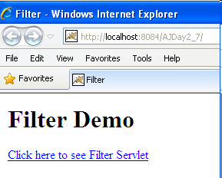
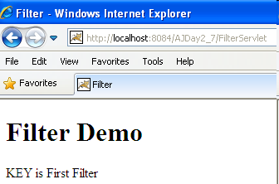
Filter Example
Building the web application shows as the following GUI in sequence

Slide 15
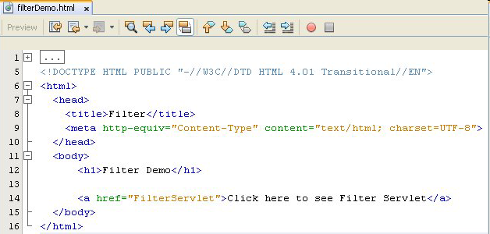
Filter Example

Slide 16
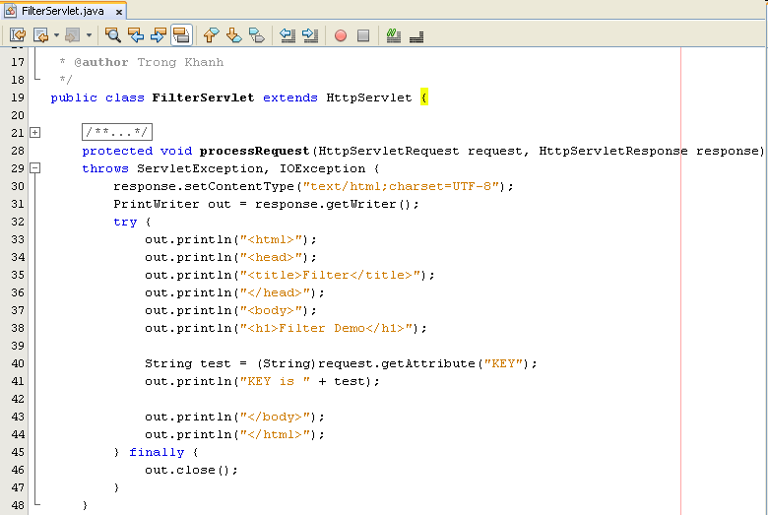
Filter Example

Slide 17
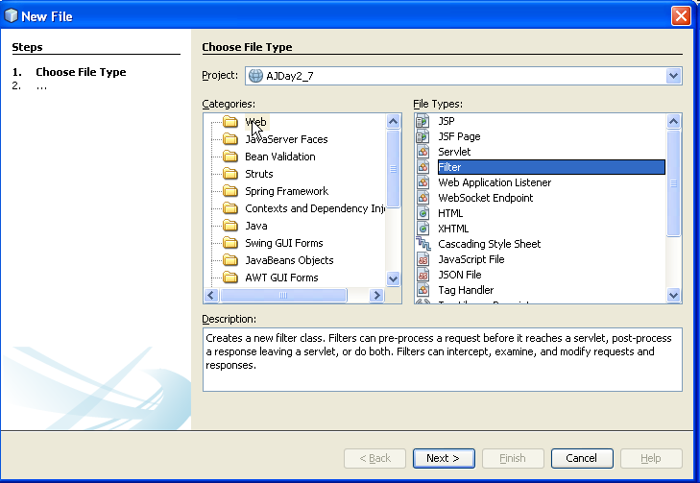
Filter Example
Click Next Button

Slide 18
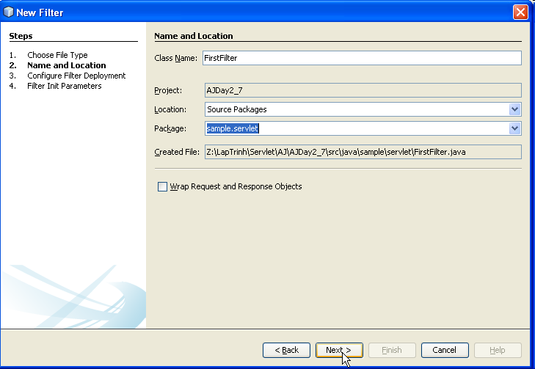
Filter Example
Fill your filter name
Fill/choose package name
Click Next Button
Notes:
Revive: hồi sinh

Slide 19
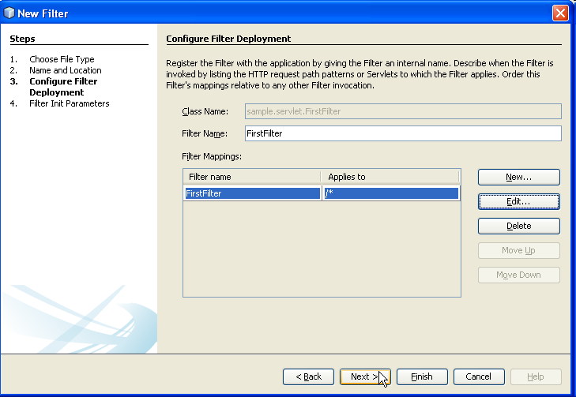
Filter Example
Apply filter
Edit the Apply filter
Click Edit Button to apply Filter the selected Servlet
Otherwise, click Finish Button

Slide 20
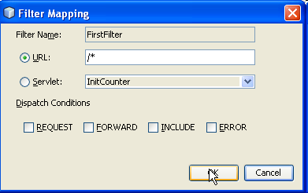
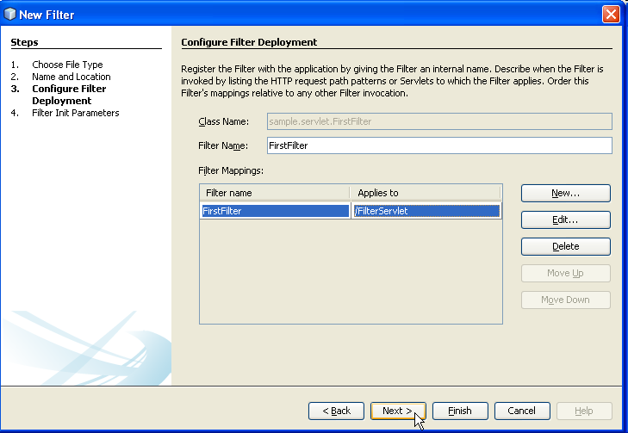
Filter Example
Select the URL and typing the URL string, or Select the Servlet and choose the approximate Servlet in combo box

Slide 21
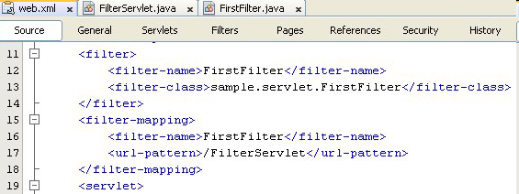
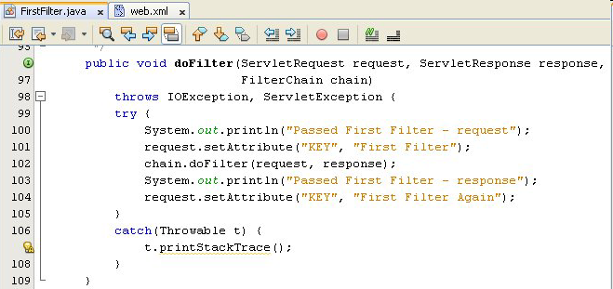
Filter Example
3. response/return
2. forward
1. request
Notes:
Cái gì đặttrước filter, đó là xử lý request
Cái gì đặc sau filter, đó là xử lý response

Slide 22
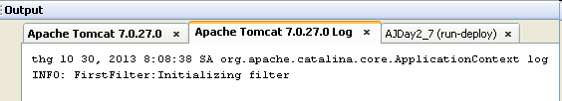
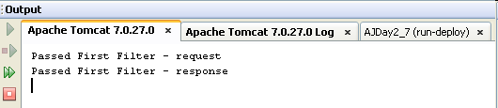
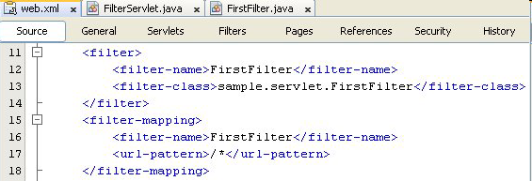
Filter Example

Slide 23
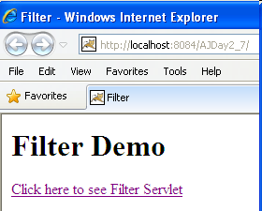

Filter Example
Notes:
Nhớ clear cache

Slide 24
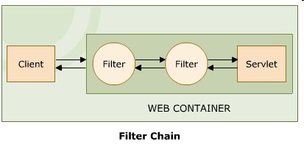
Filter Chain Definition
There can be more than one filter between the user and the endpoint – Invoke a series of filters
A request or a response is passed through one filter to the next in the filter chain. So each request and response has to be serviced by each filter forming a filter chain
If the Calling filter is last filter, will invoke web resource
FilterChain Interface
Provides an object through the web container
The object invokes the next filter in a filter chain starting from the first filter from a particular end. If the calling filter is the last filter in the chain, it will invoke the web resource, such as JSP and servlet.
Only implement doFilter() method.
Forces the next filter in the chain to be invoked

Slide 25
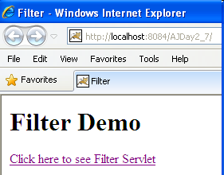
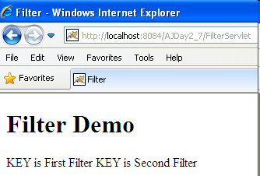
Filter Chain Example

Slide 26
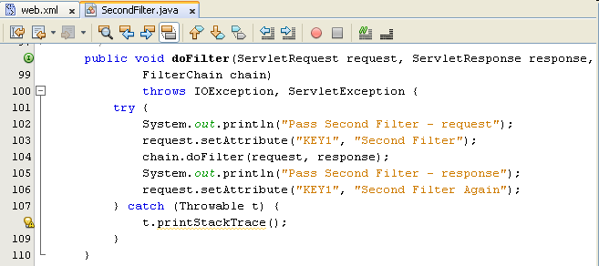
Filter Chain Example

Slide 27
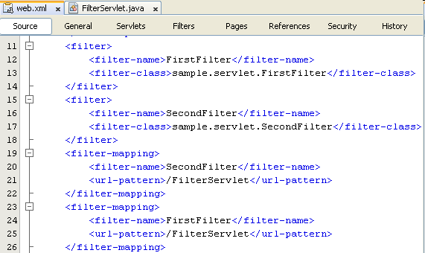
Filter Chain Example

Slide 28
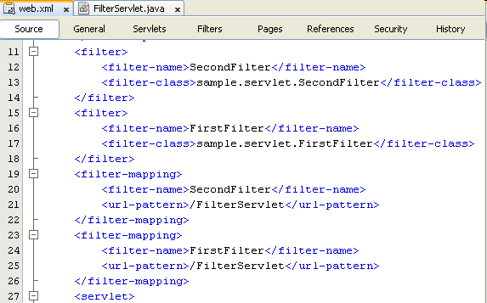
Filter Chain Example
Notes:
Sắp xếp lại để có thể làm demo đổi vị trí sẽ làm cho ứng dụng chạy tốt hơn

Slide 29
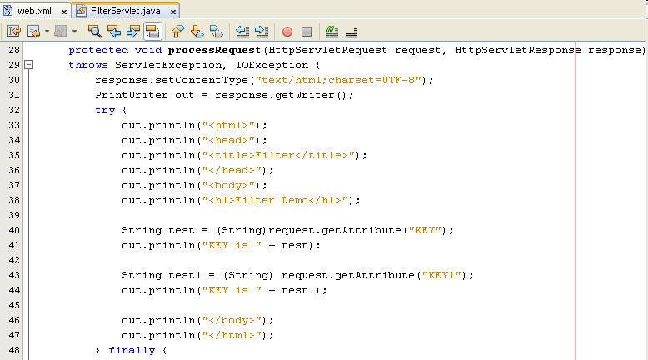
Filter Chain Example

Slide 30
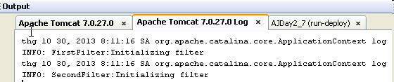
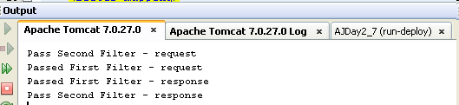
Filter Chain Example

Slide 31
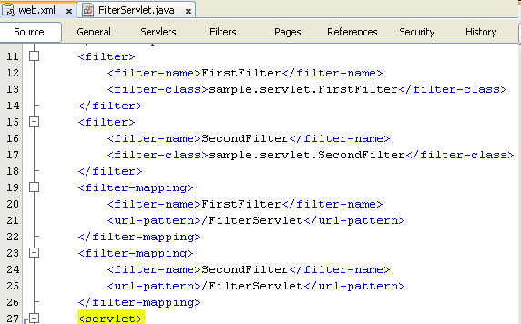
Filter Chain Example – Change position

Slide 32
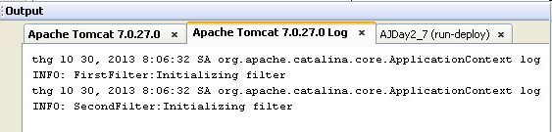
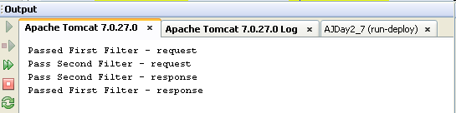
Filter Chain Example
Notes:
Thứ tự log vẫn như cũ nhưng thứ tự apply khác

Slide 33
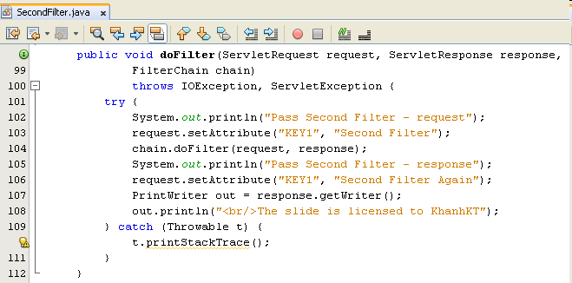
Filter Chain Why need a Wrapper Class
Notes:
Demo FilterWrapper – in ở bottom nhưng in ko được do close đóng rồi trong servlet

Slide 34
Filter Chain Why need a Wrapper Class
Notes:
Không thể in được dòng “A line of text at the bottom of your web page” vì response đã được gửi ra sao đó mới qua filter thì out đã đóng
Khi tắt out.close ở trong Servlet thì dòng trên sẽ được hiển thị vì dòng out chưa được đóng nó sẽ ảnh hưởng sang Filter
Filter cho response được xử lý sau khi Servlet được xử lý, do vậy không thể đóng out
Nếu chúng ta tắt out ở phía servlet thì kết quả sẽ được kết xuất nhưng chúng ta không thể modified object thông thường – giải pháp dùng Wrapper class

Slide 35
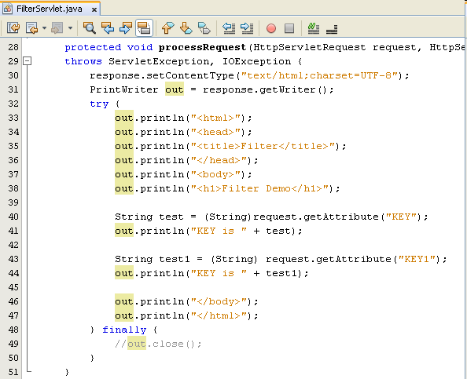
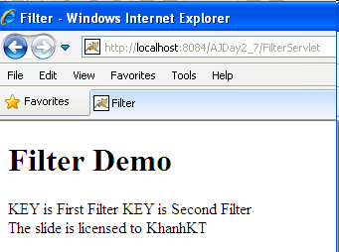
Filter Chain Why need a Wrapper Class
Notes:
Đây là một khuyết điểm vì chúng ta ko đóng đối tượng khi hoàn tất, có thể dẫn đến crash hay lỗi, do vậy cần thiết phải có wrapper để chỉnh sửa đối tượng này.

Slide 36
Filter Chain Wrapper Class
To modify or intercept the request or response before they can reach their logical destination, the required object can dynamically capture the request or response
Wrapper class
Creates the object to capture the request and response before they reach server and client respectively
The wrapper object generated by the filter implements the getWriter() and getOutputStream(), which returns a stand-in-stream. The stand-in-stream is passed to the servlet through the wrapper object
The wrapper object captures the response through the stand-in-stream and sends it back to the filter
Classes | Descriptions
ServletRequestWrapper | - Provides a convenient implementation of the ServletRequest interface - Can be sub-classed by developers wishing to send the request to a servlet - To override request methods, one should wrap the request in an object that extends ServletRequestWrapper or HttpServletRequestWrapper
ServletResponseWrapper | - Provides a convenient implementation of the ServletResponse interface - Can be sub classed by developers wishing to send the response from a servlet.

Slide 37
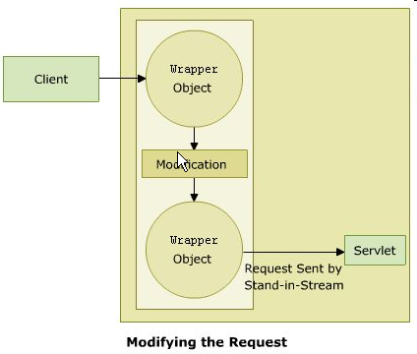
Filter Chain Wrapper Class – Altering Request
Create filter class extends to the ServletRequestWrapper or HttpServletRequestWrapper class.
The object captures the HttpRequest object from the client and sends it to the filers
Through the objects filter extends some services to the request.

Slide 38
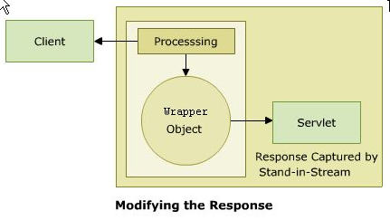
Filter Chain Wrapper Class – Altering Response
Create filter class extends to the ServletResponseWrapper or HttpServletResponseWrapper class.
The object captures the httpRequest object from the client and sends it to the filers
Through the objects filter extends some services to the request.

Slide 39
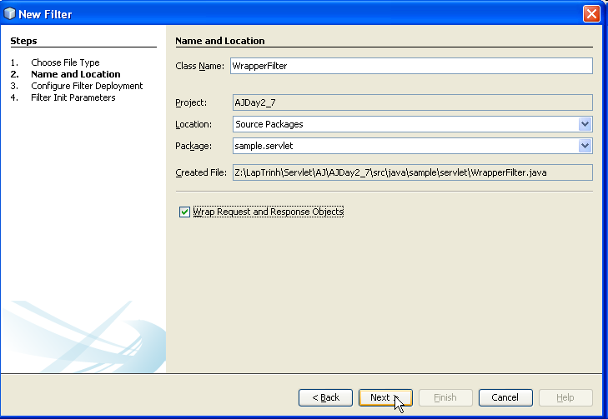
Filter Chain Wrapper Class – Example
Notes:
Tạo Filter và check vào checkbox “Wrap Request and Response Object” để tạo sẵn class cho chúng ta bao gồm cả Request lẫn Response Wrapper, chúng ta chỉ cần bổ sung MyPrineter cho chúng ta để modified và điều khiển chúng, còn thành thần Wrapper chúng ta sẽ gọi hàm modified object

Slide 40
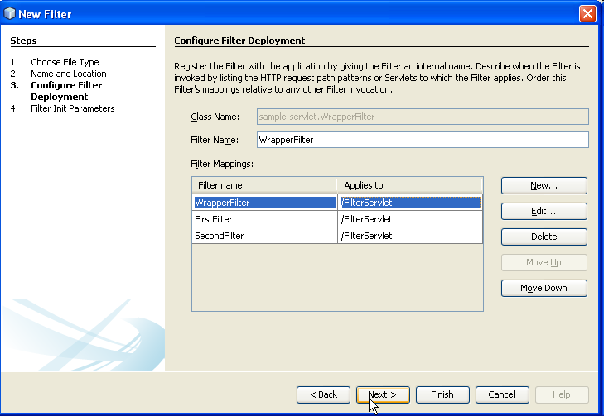
Filter Chain Wrapper Class – Example
Notes:
Tạo Filter và check vào checkbox “Wrap Request and Response Object” để tạo sẵn class cho chúng ta bao gồm cả Request lẫn Response Wrapper, chúng ta chỉ cần bổ sung MyPrineter cho chúng ta để modified và điều khiển chúng, còn thành thần Wrapper chúng ta sẽ gọi hàm modified object

Slide 41
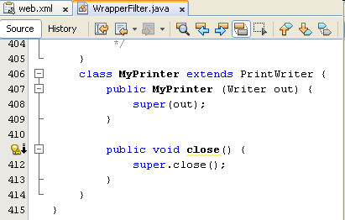
Filter Chain Wrapper Class – Example
Adding the MyPrinter class extends PrintWriter in FilterWrapper class
Notes:
Tạo Filter và check vào checkbox “Wrap Request and Response Object” để tạo sẵn class cho chúng ta bao gồm cả Request lẫn Response Wrapper, chúng ta chỉ cần bổ sung MyPrineter cho chúng ta để modified và điều khiển chúng, còn thành thần Wrapper chúng ta sẽ gọi hàm modified object

Slide 42
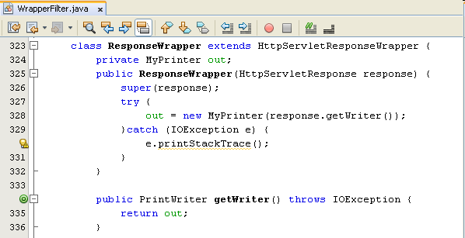
Filter Chain Wrapper Class – Example
Modifying the ResponseWrapper class uses MyPrinter to output stream
Notes:
Tạo Filter và check vào checkbox “Wrap Request and Response Object” để tạo sẵn class cho chúng ta bao gồm cả Request lẫn Response Wrapper, chúng ta chỉ cần bổ sung MyPrineter cho chúng ta để modified và điều khiển chúng, còn thành thần Wrapper chúng ta sẽ gọi hàm modified object

Slide 43
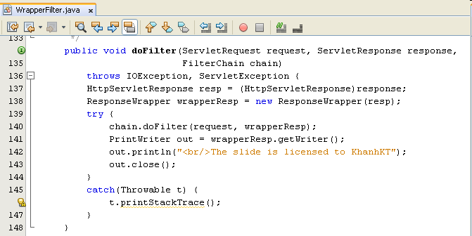
Filter Chain Wrapper Class – Example
Notes:
Tạo Filter và check vào checkbox “Wrap Request and Response Object” để tạo sẵn class cho chúng ta
Ở đây cho dù, chúng ta để hàm out.close ở Servlet nhưng khi chuyển sang filter chúng ta đã mở object riêng chúng ta và mở một out – response mới để chỉnh sửa, do vậy, độc lập hoàn toàn với servlet, ko ảnh hưởng
Kết quả ra sẽ có tiêu đề nhưng phải mở out.close

Slide 44
MVC2 Filter Acts as Controller
While a servlet is the most common controller, a filter can act as a controller too
While a servlet only handles access to the dynamic part of the application, a filter can serve all the resources in application, including static ones
A filter as the controller allows to block all requests to the application, including request for static contents

Slide 45
Summary
1. Input and click button/link
3. Send request
4. Dispatch to Servlet/Web Container
Web/App Server
Containter
Filter 1 ..n
6. Process Request
2. Generate the Request msg
5. Generate Req Obj
7. chain.doFilter to n
→ pass request
12. Send response
8. Forward Request
10. Process Response (from n to 1) & Response
Resource
11. Container generate Res Msg
Client
9. Execute & Response
Server
Q&A

Slide 46
Summary
Web based App - PBL
Web
Day 1, 2, 3, 4, 5, 6 – Login
Servlet, JDBC
Day 7, 8, 9 – Search
Break Down
Day 10, 11 – MVC2
JSP
Day 12, 13, 14, 15 – CUD, Shopping Carts
Sessions
Day 16, 17 – Login
JavaBeans
Day 18, 19, 20 – CRUD
MVC 2 Complete - JSTL - Taglib
Day 21, 22, 23 – Filter
MVC2 Using Filter as Controller

Slide 47
Next Days
Practice with exercises
Practical Test
Presentations
Good luck to you!!!

Slide 48
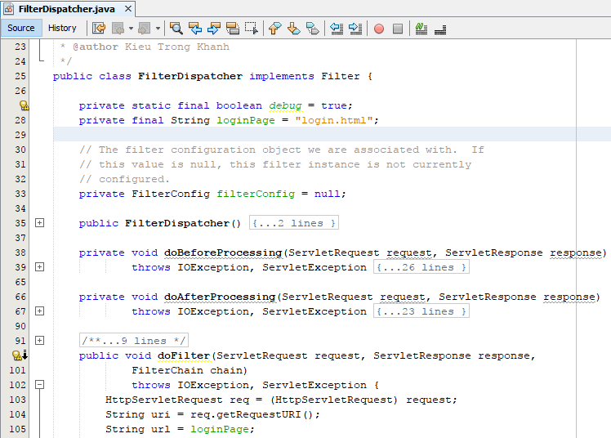
Appendix MVC2 using Filter as Controller

Slide 49
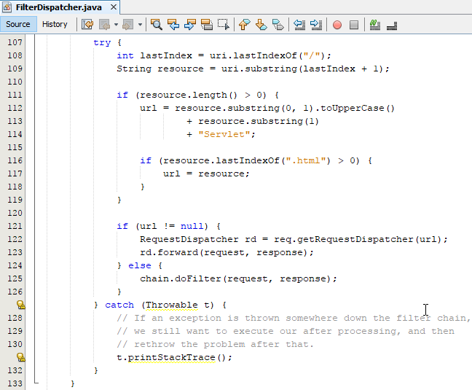
Appendix MVC2 using Filter as Controller

Slide 50
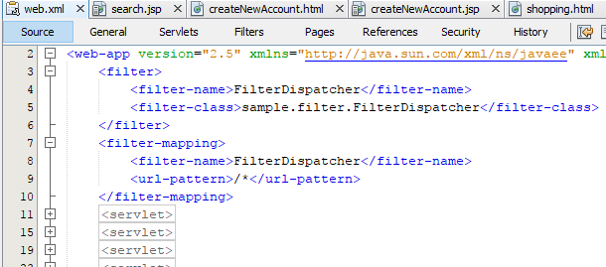
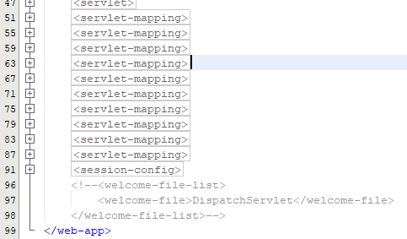
Appendix MVC2 using Filter as Controller

Slide 51
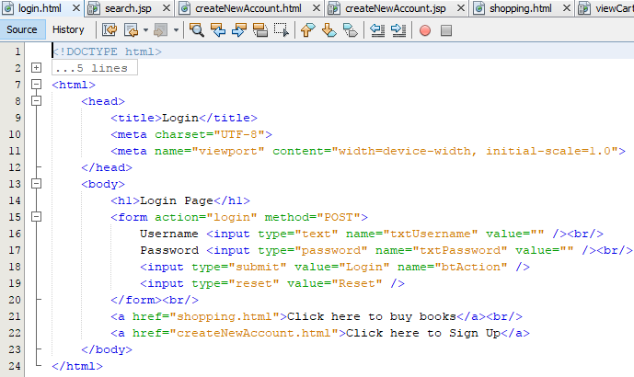
Appendix MVC2 using Filter as Controller

Slide 52
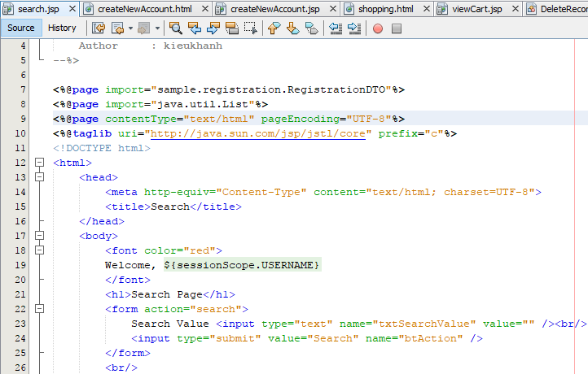
Appendix MVC2 using Filter as Controller

Slide 53
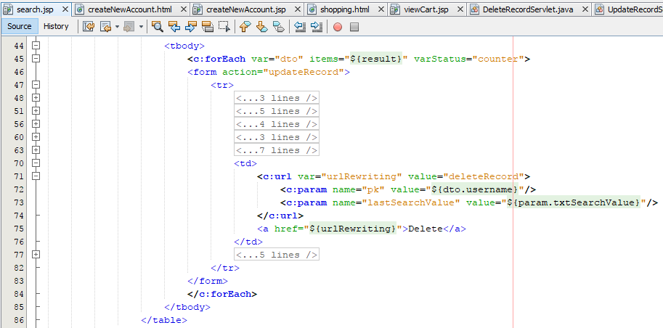
Appendix MVC2 using Filter as Controller

Slide 54
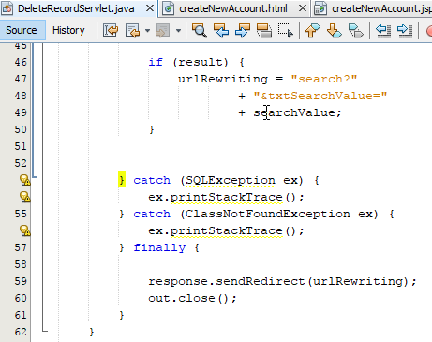
Appendix MVC2 using Filter as Controller

Slide 55
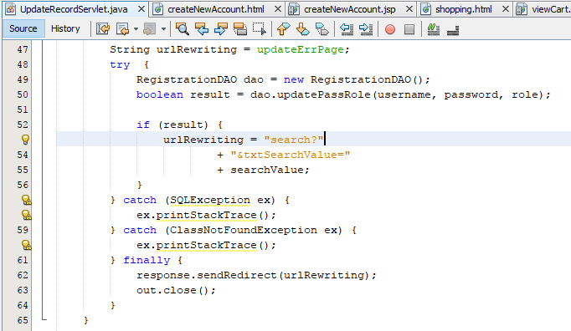
Appendix MVC2 using Filter as Controller

Slide 56
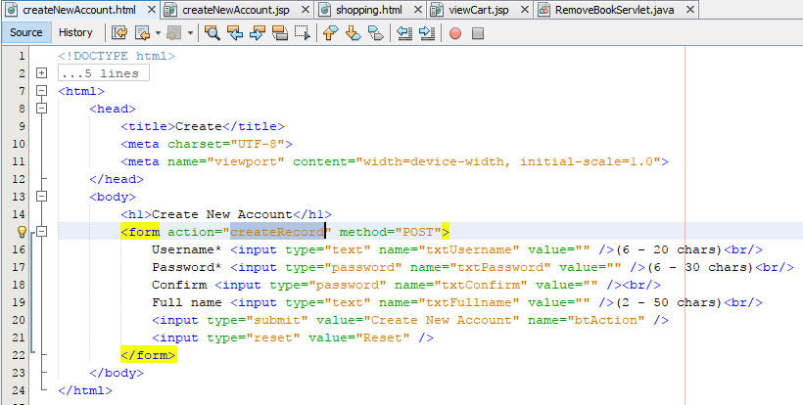
Appendix MVC2 using Filter as Controller

Slide 57
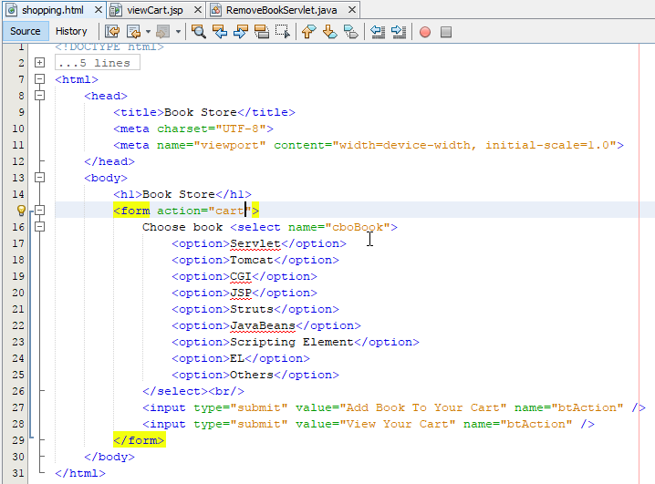
Appendix MVC2 using Filter as Controller

Slide 58
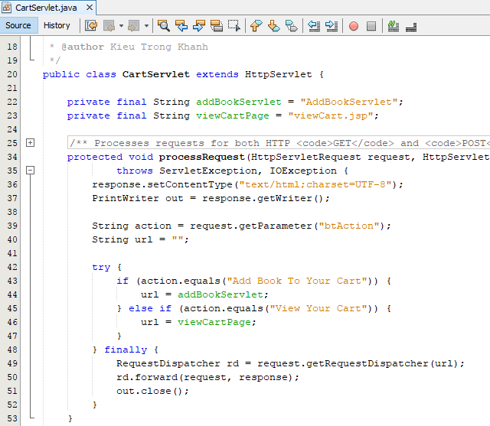
Appendix MVC2 using Filter as Controller

Slide 59

Appendix MVC2 using Filter as Controller

Slide 60

Appendix MVC2 using Filter as Controller

Slide 61


Appendix MVC2 using Filter as Controller

